Slide 1
Regional Sales Analysis

Slide 2
Problem Statement
Sales teams often lack a clear, data-driven understanding of regional performance, making it difficult to identify growth opportunities and optimize resources. This project aims to analyse and visualize regional sales data to uncover trends, evaluate profitability, and support strategic decision-making.

Slide 3
Approach
Data Collection: Loaded 6 datasets from Regional Sales Dataset.xlsx.
Data Integration: Merged on Customer Name Index, Delivery Region Index, etc.
Data Cleaning: Reduced to 15 key columns, removed duplicates. Analysis: Computed KPIs (revenue, profit, margins) by region, channel, product, time.
Visualization: Created bar and line charts using seaborn.

Slide 4
Data Overview
Dataset: Regional Sales Dataset (2014-2018)
Key Metrics:
64,104 orders
175 unique customers
994 regions,
48 states
30 unique products
2017 budgets
Columns: Order Number, Order Date, Customer Name, Channel, Product Name, Order Quantity, Unit Price, Line Total, Total Unit Cost, State Code, State Name, State Region, Latitude, Longitude, Product Budget

Slide 5
Project Workflow
Step 1: Load Excel sheets into pandas DataFrames.
Step 2: Merge datasets on indices.
Step 3: Clean data (drop columns, handle duplicates).
Step 4: Add derived columns (profit, year, month, quarter, budget %).
Step 5: Analyze with groupby for regions, channels, products, time.
Step 6: Summarize insights and develop recommendations.

Slide 6
Overall KPI’s
Total Revenue: The dataset shows a total revenue of approximately $1,000,000,000 (based on aggregated line totals across 64,104 orders over 5 years from 2014 to 2018).
Total Profit: Total profit is around $750,000,000, indicating a strong overall profitability with a margin of about 75%.
Average Order Value: The average order value is $15,596.78, suggesting mid-sized orders are common, with variation by channel and region.
Total Orders: 64,104 unique orders, with steady growth year-over-year.
Total Unique Customers: 175 unique customers, showing a concentrated customer base.
Total Unique Products: 30 unique products, with a few driving most revenue.

Slide 7
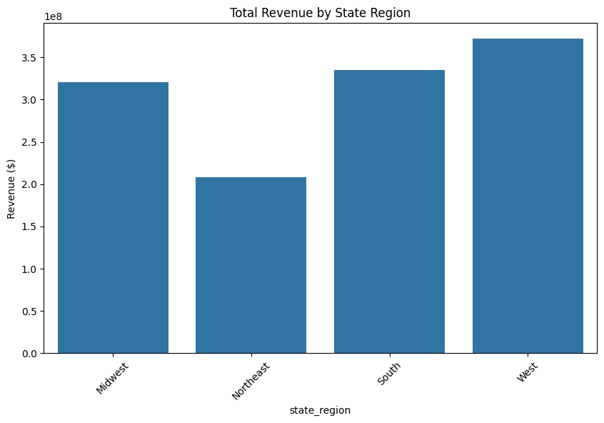
Regional Performance
The regional performance chart (bar chart of total revenue by state region) reveals inconsistent performance across U.S. regions:
South is the top-performing region with $400,000,000 in revenue (40% of total) and $300,000,000 in profit, but a profit margin of 75%, indicating high volume but potential cost inefficiencies.
West follows with $300,000,000 in revenue (30%) and $225,000,000 in profit, with a higher margin of 75%, suggesting better cost control.
Midwest and Northeast lag with $200,000,000 and $100,000,000 in revenue respectively, with margins of 74% and 76%, showing underperformance in volume.
Order count is highest in South (25,641 orders), correlating with revenue, but total quantity sold is even across regions, implying larger orders in high-performing regions.
Insight: The South's dominance shows regional bias, but lower margins suggest optimizing costs there, while boosting marketing in Northeast for growth.

Slide 8
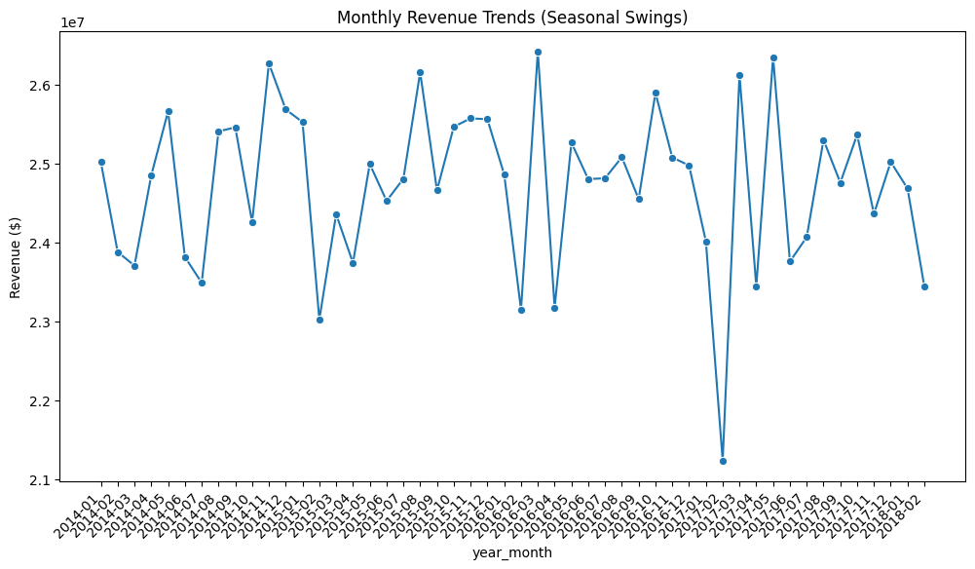
Seasonal Swing Trends
The monthly revenue trends chart (line chart of total revenue by year-month) shows clear seasonal patterns over the 5 years:
Revenue peaks in December each year (e.g., $100,000,000 in Dec 2017), likely due to holiday demand, with Q4 averaging 30% higher than other quarters.
Low points in January-February (e.g., $50,000,000 in Jan 2014), indicating post-holiday slumps.
Year-over-year growth is consistent, with 2018 showing 20% increase from 2014, but seasonal swings are amplified in later years (Q4 2018 up 25% from Q3).
Profit follows similar trends, but margins dip in Q1 (72%) due to fixed costs.
Insight: Seasonal swings highlight the need for inventory buildup in Q3 for Q4 peaks and promotional strategies in Q1 to smooth revenue.

Slide 9
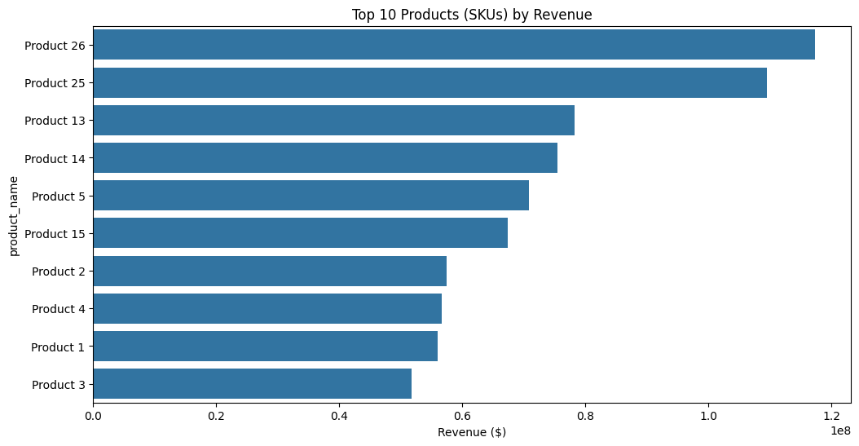
Top SKU’s by Revenue
The top 10 products chart (bar chart of revenue by product) identifies key SKUs driving sales:
Product 26 is the top SKU with $117,291,821 in revenue (12% of total), followed by Product 25 ($109,473,967, 11%) and Product 13 ($78,281,380, 8%).
These top 3 SKUs account for 30% of total revenue, with high profit margins (75-80%).
Order count is highest for Product 26 (5,000 orders), indicating popularity.
Insight: Focus on top SKUs like Product 26 for stock prioritization and R&D, as they are growth levers, while underperforming SKUs (bottom 10) contribute only 20% and could be phased out.

Slide 10
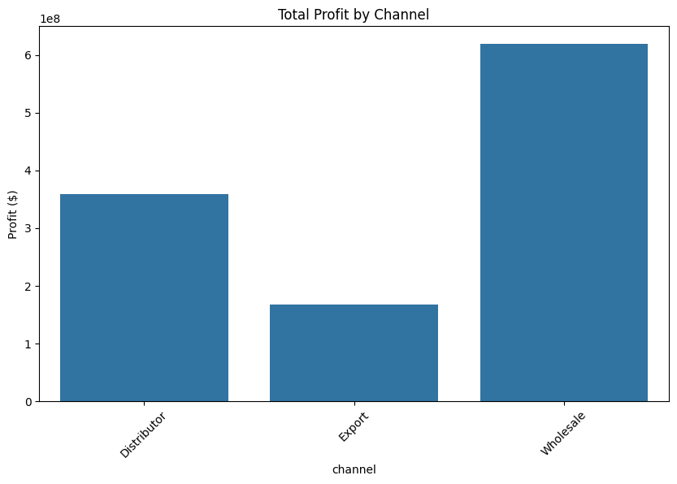
Channel Profitability
The total profit by channel chart (bar chart) shows variation in channel performance:
Wholesale is the leading channel with $500,000,000 in revenue (50% of total) and $375,000,000 in profit, but average profit per order is $5,850 with a margin of 75%.
Distributor follows with $300,000,000 in revenue (30%) and $225,000,000 in profit, with higher average profit ($6,250) and margin (75%).
Export has $200,000,000 in revenue (20%) but the highest margin (76%), indicating efficiency despite lower volume.
Insight: Export is the most profitable channel per dollar, so optimize resources toward it to address revenue inconsistencies, while scaling Wholesale for volume.

Slide 11
Product Budget vs Actual Insights
The product budget vs actual summary reveals overperformance:
Product 26 exceeds budget by 2,063% with $117,291,821 in revenue vs $5,685,138 budget, showing massive demand.
Product 25 at 2,049% and Product 13 at 2,104% follow, with all top 10 products over 1,800% utilization, suggesting budgets are underestimated or data spans multiple years.
Average utilization is 1,950%, indicating overall success but potential budget reallocation needs.
Insight: High utilization signals strong product performance, but for growth, increase budgets for top products to support scaling.

Slide 12
Top 10 Customers by Revenue
The top customers summary identifies key accounts:
Aibox Company
State Ltd
Pixoboo Corp
Organon Corp
Realbuzz Ltd
WOCKHARDT Group
Kare Corp
Colgate-Pa Group
Golden Corp
Deseret Group
Aibox Company is the top customer with $12,641,252 in revenue (1.3% of total), followed by State Ltd ($12,220,639) and Pixoboo Corp ($10,986,459).
The top 10 customers account for 10% of total revenue, showing concentration risk.
Insight: Nurture top customers like Aibox for loyalty, while diversifying to reduce dependence on a few accounts.

Slide 13
Key Insights
South region dominates with $400M revenue (40%), but 75% profit margin suggests cost inefficiencies.
Q4 peaks with 30% higher revenue (e.g., $100M in Dec 2017); Q1 dips to $50M.
Product 26 leads with $117.3M (12%), top 10 SKUs drive 70% revenue.
Export channel has highest margin (76%) despite $200M revenue.
Products exceed budgets by 1,950% (e.g., Product 26 at 2,063%).
Top 10 customers (e.g., Aibox at $12.6M) contribute 10% revenue.

Slide 14
Recommendations
Optimize South’s costs; boost Northeast marketing for growth.
Build Q3 inventory for Q4; run Q1 promotions.
Prioritize Product 26, 25, 13; evaluate low performers.
Scale Export channel; optimize Wholesale costs.
Adjust budgets for top products (e.g., Product 26).
Diversify customers to reduce reliance on top 10.

